Slide 1
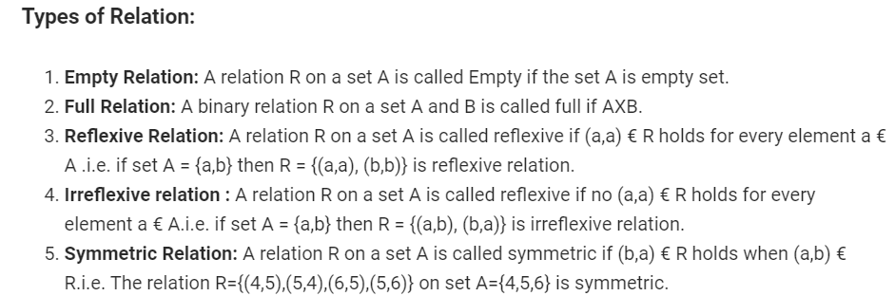
LECTURE-12 RELATION, OPERATION & REPRESENTATION OF RELATION
Relation or Binary relation R from set A to B is a subset of A x B which can be defined as a R b ↔ (a,b) € R ↔ R(a,b).
A Binary relation R on a single set A is defined as a subset of A x A. For two distinct set, A and B with cardinalities m and n, the maximum cardinality of the relation R from A to B is mn.

Slide 3
Important Points:
1. Symmetric and anti-symmetric relations are not opposite because a relation R can contain both the properties or may not.
2. A relation is asymmetric if and only if it is both anti-symmetric and irreflexive.
3. Number of different relation from a set with n elements to a set with m elements is 2mn.

Slide 4
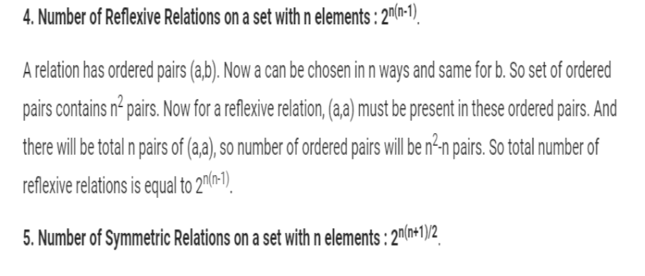

Slide 6
Representation of Relations :
Relations can be represented in many ways. Some of which are as follows:
1. Relation as a Matrix: Let P = [a1,a2,a3,.......am] and Q = [b1,b2,b3......bn] are finite sets, containing m and n number of elements respectively. R is a relation from P to Q. The relation R can be represented by m x n matrix M = [Mij], defined as
Mij = 0 if (ai ,bj) ∉ R
1 if (ai,bj )∈ R
EXAMPLE: Let P = {1, 2, 3, 4}, Q = {a, b, c, d}
and R = {(1, a), (1, b), (1, c), (2, b), (2, c), (2, d)}.
The matrix of relation R is shown as fig:
Representation of Relations :

Slide 7
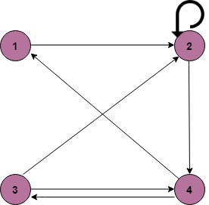
2. Relation as a Directed Graph: There is another way of picturing a relation R when R is a relation from a finite set to itself.
Example
A = {1, 2, 3, 4}
R = {(1, 2) (2, 2) (2, 4) (3, 2) (3, 4) (4, 1) (4, 3)}
Representation of Relations :

Slide 8
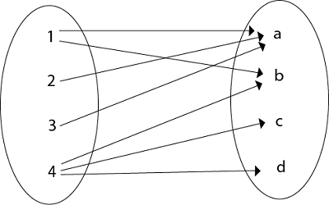
3. Relation as an Arrow Diagram: If P and Q are finite sets and R is a relation from P to Q. Relation R can be represented as an arrow diagram as follows.
Draw two ellipses for the sets P and Q. Write down the elements of P and elements of Q column-wise in three ellipses. Then draw an arrow from the first ellipse to the second ellipse if a is related to b and a ∈ P and b ∈ Q.
Example:
Let P = {1, 2, 3, 4}
Q = {a, b, c, d}
R = {(1, a), (2, a), (3, a), (1, b), (4, b), (4, c), (4, d)
The arrow diagram of relation R is shown in fig:

Slide 9
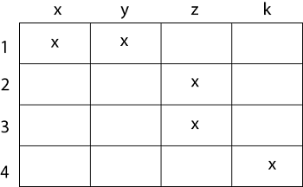
4. Relation as a Table: If P and Q are finite sets and R is a relation from P to Q. Relation R can be represented in tabular form.
Make the table which contains rows equivalent to an element of P and columns equivalent to the element of Q. Then place a cross (X) in the boxes which represent relations of elements on set P to set Q.
Example:
Let P = {1, 2, 3, 4}
Q = {x, y, z, k}
R = {(1, x), (1, y), (2, z), (3, z), (4, k)}.
The tabular form of relation as shown in fig:

Slide 10
Composition of Relations
Let A, B, and C be sets, and let R be a relation from A to B and let S be a relation from B to C. That is, R is a subset of A × B and S is a subset of B × C. Then R and S give rise to a relation from A to C indicated by R◦S and defined by:
a (R◦S)c if for some b ∈ B we have aRb and bSc.
is,
R ◦ S = {(a, c)| there exists b ∈ B for which (a, b) ∈ R and (b, c) ∈ S}
The relation R◦S is known the composition of R and S; it is sometimes denoted simply by RS.
Let R is a relation on a set A, that is, R is a relation from a set A to itself. Then R◦R, the composition of R with itself, is always represented. Also, R◦R is sometimes denoted by R2. Similarly, R3 = R2◦R = R◦R◦R, and so on. Thus Rn is defined for all positive n.
Example1: Let X = {4, 5, 6}, Y = {a, b, c} and Z = {l, m, n}. Consider the relation R1 from X to Y and R2 from Y to Z.
R1 = {(4, a), (4, b), (5, c), (6, a), (6, c)}
R2 = {(a, l), (a, n), (b, l), (b, m), (c, l), (c, m), (c, n)}

Slide 11
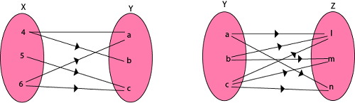
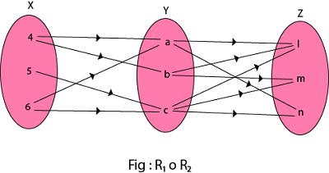
Find the composition of relation (i) R1 o R2 (ii) R₁o R₁⁻¹ Solution:
The composition relation R1 o R2 as shown in fig:
R1 o R2 = {(4, l), (4, n), (4, m), (5, l), (5, m), (5, n), (6, l), (6, m), (6, n)}

Slide 12
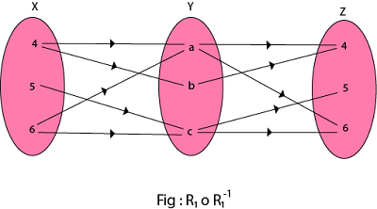
(ii) The composition relation R₁o R₁⁻¹ as shown in fig:
R₁o R₁⁻¹ = {(4, 4), (5, 5), (5, 6), (6, 4), (6, 5), (4, 6), (6, 6)}

Slide 13
Questions :
1. How many binary relations are there on a set S with 9 distinct elements?
2⁹⁰ b) 2¹⁰⁰ c) 2⁸¹ d) 2⁶⁰
2. _________ number of reflexive relations are there on a set of 11 distinct elements. a) 2¹¹⁰ b) 3¹²¹ c) 2⁹⁰ d) 2¹³²
^{3.} The number of reflexive as well as symmetric relations on a set with 14 distinct elements is __________ a) 4¹²⁰ b) 2⁷⁰ c) 3²⁰¹ d) 2⁹¹
4. The number of symmetric relations on a set with 15 distinct elements is ______ a) 2¹⁹⁶ b) 2⁵⁰ c) 2³²⁰ d) 2⁷⁸

